Slide 1
Structure & Management of Organizations
Chapter 9
CS449-Professioal Issues in Information Technology
Course Instructor: Eng. Khalid Iqbal Soomro

Slide 2
Chapter Outcome
After studying this chapter, you should be able, in the context of organizations with which you are familiar, to:
recognize how they are structured;
suggest alternative possible structures and identify their advantages and disadvantages.

Slide 3
Introduction
An organization is a group of people working together in a formal way. What this means is that the work that has to be done is shared between these people and that there are rules about who does what.
How the work is shared, and how tasks and people are grouped together - the structure of the organization-will vary very much from organization to organization.
It is surprising, however, that organizational structures have much more in common than might be expected.

Slide 4
ORGANIZATIONAL MODELS
The Bureaucratic model
Organizational theory goes back to the end of the 19th century. The founders were sociologists like Max Weber and Mary Parker Follett, and business people like Henri Fayol and Lyndall Urwick.
They developed what is known as the bureaucratic model.
In a modified form, this model still describes the organizational structures to be found in many larger or smaller, organizations.

Slide 5
ORGANIZATIONAL MODELS…..
The ideal bureaucratic organization was thought to have the following characteristics:
1. All tasks are split up into specialized jobs, in which jobholders become experts; management can thereby hold the jobholders responsible for the effective performance of their duties.
2. The performance of each task is governed by precise rules. This means that there should be no variation in the way tasks are carried out and therefore no problems with the co-ordination of different tasks.

Slide 6
ORGANIZATIONAL MODELS…..
3. Each individual in the organization is accountable to one and only one manager.
4. In order to ensure that personalities and personal relationships do not interfere with the organization’s performance, employees are required to relate both
to other employees and to clients in an impersonal
and formal manner.
5. Recruitment is based on qualifications & employees are protected against arbitrary dismissal. Promotion is based on seniority and achievement. Life-time employment is forbidden.

Slide 7
ORGANIZATIONAL MODELS…..
These ideas have proved surprisingly long lasting. Remnants even of rule 4 above were still to be found in banks and local authorities in the 1980s.
In the 1970s, it was still the case in some companies that if two employees became engaged to be married then one of them would be required to resign.
It is an inevitable consequence of these rules that the organization will be hierarchical and that its structure can be represented as a tree.

Slide 8
ORGANIZATIONAL MODELS…..
Despite the obvious weaknesses of the approach, it brings many benefits and many companies were run successfully along these lines for many years.
Modernized and liberalized versions are still to be found working successfully, particularly in production line industries.
More problems were observed when companies applied these ideas to software production, by separating the tasks of writing code, compiling, correcting, testing and then assigning them to three different groups of coders.

Slide 9
ORGANIZATIONAL MODELS…..
The Organic model
The best known alternative model is the organic model, particularly associated with Rensis Lickert. He expresses the basic assumption of the model in the following (rather verbose) terms:
An organization will be effective to the extent that its structure is such as to ensure a maximum probability that in all interactions and in relationships within the organization, each member, in the light of his values, background, desires, and expectations, will view the experience as supportive and one which builds a sense of personal worth and importance.

Slide 10
ORGANIZATIONAL MODELS…..
This view underlies the organizational structure of most small professional companies, software houses, and advertising agencies; it is also common in academic institutions, both schools and universities.
The view is not necessarily consciously articulated, nor is this view and the adoption of the structures it suggests sufficient to achieve effectiveness!
Supporters of the bureaucratic model claim that it is universally applicable. Supporters of the organic model make similar claims.

Slide 11
ORGANIZATIONAL MODELS…..
Matrix management
It is an essential feature of the bureaucratic model that every individual and every unit in the organization is responsible to only one manager.
This is not realistic in the context of project-based, high-technology companies.
A specialist in high-speed communications, working for a systems integrator, may find himself working on two or three projects simultaneously, as well as having a more general responsibility for maintaining the company’s expertise in the area.

Slide 12
ORGANIZATIONAL MODELS…..
In the past 30 years or so the idea of matrix management has become fashionable as a way of addressing such situations.
It accepts that individuals may be responsible to more than one manager and requires rules that will enable possible conflicts to be resolved.
Some organizations and some management consultants have tried to formulate the matrix management model much more formally. The results are not encouraging.

Slide 13
STRUCTURING PRINCIPLES
The bureaucratic model tells us about the way individuals and groups in an organization relate to each other. But it tells us nothing about how to group together the tasks and activities that have to be carried out.
In practice, there are many different ways of doing this and these models are mutually exclusive. In all of the companies, different parts of the organization are likely to show different ways of producing a structure.
Furthermore, the structures produced by the different criteria may be combined in a matrix structure.

Slide 14
STRUCTURING PRINCIPLES…..
Structure by function
In almost every organization, we can identify certain groups of activities that have to be carried out and that fit naturally together.
First of all, there are the activities that are the primary purpose of the organization. These activities are known as operations.
The primary purpose of a school is to teach students.
The primary purpose of a hospital is to cure sick people.
The primary purpose of a software company is to provide software for its customers.

Slide 15
STRUCTURING PRINCIPLES…..
Secondly, almost all organizations have to pay their bills and pay their employees. They need to ensure that the buildings they use are cleaned regularly.
If they charge for their services, they may need to send out bills and ensure that these are paid.
They will probably need to hire new employees from time to time. These activities are generally known as administration.
While operations in different types of organization will be very different, administration varies much less.

Slide 16
STRUCTURING PRINCIPLES…..
Thirdly, many organizations will need to publicize their services or their products and try to persuade people to use them or buy them.
In the business world these activities are usually known as sales and marketing.
Strictly speaking, marketing means the activities involved in making potential customers aware of the products the business can offer; it also includes planning new products on the basis of what the company might provide and what customers would like.

Slide 17
STRUCTURING PRINCIPLES…..
Selling or sales is the activity of persuading individual customers to buy from the company.
It is often thought that sales and marketing are activities restricted to commercial organizations. This is not the case.
Health services try to persuade people to go for check-ups and to participate in screening programs.
Publicizing these services is a marketing activity; sending out specific invitations to individuals is a sales activity.

Slide 18
STRUCTURING PRINCIPLES…..
Finally, many organizations need to be continually developing new products or services, or developing new ways to deliver them. These activities are known as research and development.
A structure based on functions, with an administrative division, an operations division, a sales and marketing division, and possibly a research and development division, is the commonest type of structure to be found in medium-sized companies.
This is illustrated in Figure 9.1.

Slide 19
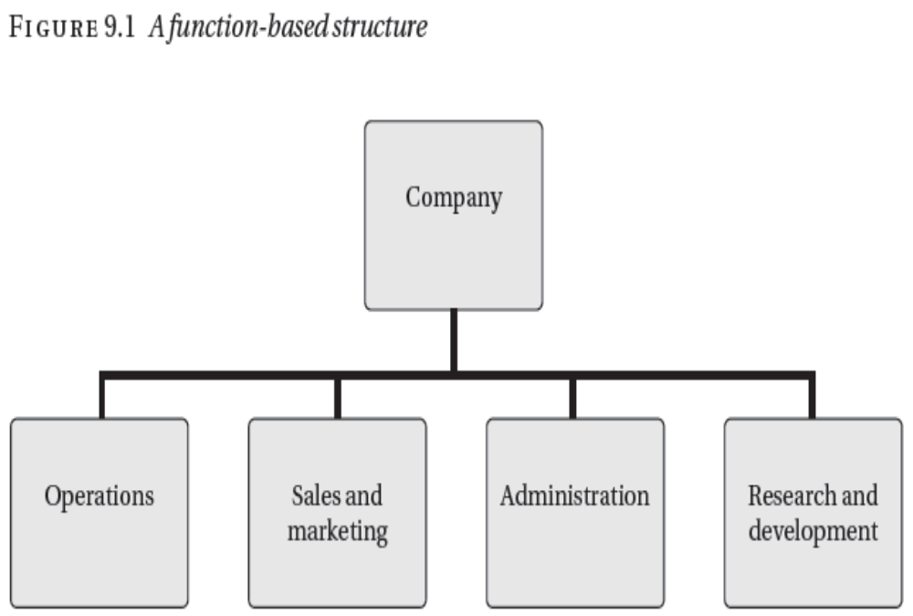
STRUCTURING PRINCIPLES…..

Slide 20
STRUCTURING PRINCIPLES…..
Structure by geography
In many cases it makes sense to group activities together on a geographical basis. Multinational companies are usually forced to have some geographical elements in their structure.
In most cases, in order to operate effectively in a country, they will need a permanent presence there, and this requires that they have a legal personality, usually in the form of a subsidiary company registered in the country but owned by the parent.

Slide 21
STRUCTURING PRINCIPLES…..
The subsidiaries are subject to the laws of the countries in which they are registered, in particular, the laws regarding employment, accounting and taxation.
These laws differ markedly from country to country so each subsidiary will need its own administrative capability.
Linguistic and cultural factors will usually mean that sales and marketing have to be locally based; certainly this is the case if the company’s customers are consumers.

Slide 22
STRUCTURING PRINCIPLES…..
Within a single country, geographical factors have become less important as a result of the development of modern communications and, as a result, geographical structures have been replaced by structures based on other factors.
British banks, for example, operated through local branches that provided all but the very largest customers with all the banking services they required.
The local branches themselves were under the control of regional management, based on geographical regions.

Slide 23
STRUCTURING PRINCIPLES…..
Now that customers can do much of their banking online over the internet, the role of the local branch and the extent of its manager’s authority are steadily declining.
Instead, the banks have moved towards a product line organization, in which different banking services (current accounts, loans, investment advice, and so on) are provided by different divisions of the bank, independent of the local branches.

Slide 24
STRUCTURING PRINCIPLES…..
Product line structure
A product line structure is based around different types of product that an organization produces.
This type of structure is very common in the engineering industry, for example, where a motor vehicle manufacturer organizes around types of vehicle.
Software companies who support corporate customers, for a multi-user accounting package, often have three main operational divisions: development and maintenance of software, consultancy, and training.

Slide 25
STRUCTURING PRINCIPLES…..
Software-houses should be regarded as a product line structure since the three types of activity,
  providing software,
  giving advice to companies in how to use it,
  providing training for customer staff,
These are three different services that the company provides and are provided by different teams of people.
Large multinational companies often show a mixture of functional, geographical and product line structures.

Slide 26
STRUCTURING PRINCIPLES…..
A good example is Cadbury Schweppes, which produces beverages and confectionery.
It has six global functional units: Human Resources, Legal, Finance, Supply Chain, Commercial Strategy and Science and Technology.
It also has five operating units that are defined partly in geographical terms and partly in terms of the two major product lines, beverages and confectionery.
Figure 9.2 shows the structure.

Slide 27
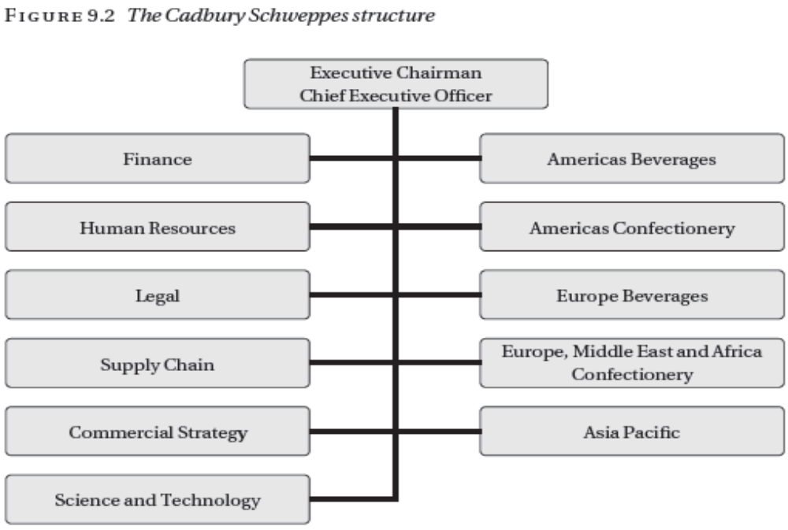
STRUCTURING PRINCIPLES…..

Slide 28
STRUCTURING PRINCIPLES…..
Structure by market sector
This term means structure based on the different market sectors to which its customers or prospective customers belong.
This approach is very popular within the software industry.
From the sales and marketing point of view it has the great advantage that each division can identify its potential customers, and its staff, both sales and technical, are familiar with customers’ problems and to speak a language that the customer understands.

Slide 29
STRUCTURING PRINCIPLES…..
There are two setbacks to this approach. First, there is the risk one division be unaware of technological expertise that exists in another division. This may lead to inefficient use of resources through unnecessarily hiring additional specialists or employing consultants, or failing to learn from mistakes made by other parts of the company.
The second danger with a structure based on market sector is that, by continuing to concentrate on its traditional areas even when these markets are becoming saturated, the company will miss new opportunities and will stagnate.

Slide 30
STRUCTURING PRINCIPLES…..
Structure by technology
A technology-based structure was once a favorite model for software companies.
Thus, a company might have divisions specializing in:
Artificial intelligence
Communications
Web-based systems
Databases
Real-time systems

Slide 31
STRUCTURING PRINCIPLES…..
There are several problems with this type of structure:
It usually requires several different technologies to meet a customer’s needs
There are many applications that cannot be said to require specific technologies
There are not many competent software engineers whose expertise runs across a number of technologies
It is difficult, if not impossible, for sales and marketing staff to predict which potential clients will need which technology

Slide 32
STRUCTURING PRINCIPLES…..
The most serious problem for companies that are primarily structured by technology is finding their clients.
In marketing terms, they are not sufficiently ‘customer-focused’ – they concentrate on selling the technologies rather than finding out customer needs.

Slide 33
STRUCTURING PRINCIPLES…..
Operational structure
The actual operations of a company is organized on a project basis or on a production basis, although the line separating the two may be vague.
A project is an activity that has specific objectives that have to be achieved within a fixed time period and fixed expenditure of resources.
In some companies, nearly all the revenue-earning activities are project based. This is true of companies that write customize software or do system integration work.

Slide 34
STRUCTURING PRINCIPLES…..
Project-based activity is not restricted to operations. Most R&D activity is organized on a project basis.
Such administrative activities as, introducing a new accounting system, or transferring a company’s head office, are also regarded as projects, in that they last for a fixed length of time, after which they should be complete.
Projects last a comparatively long time but the team carrying out the work only stays together for the length of the project.

Slide 35
STRUCTURING PRINCIPLES…..
Production activities are comparatively short, but the team carrying them out stays in existence indefinitely.
The central data processing operations of a company are organized on a production basis. There is a schedule of programs: payroll, accounts-payable, accounts-receivable, and so on, that have to be run regularly on specific dates.
It is the job of the operations team to ensure that these activities are completed on schedule.
Although the individuals in the team will change from time to time, but the team itself will continue to exist.

Slide 36
STRUCTURING PRINCIPLES…..
For an employee, the difference between project based or production based structures is very clear.
If the activities are structured on a project basis, they will find their working environment - their colleagues, their clients, or the job they are doing - changing rapidly every few weeks or months, moving from project to project.
If they are working in a production environment, change will be slower and more gradual. One environment is not generally preferable to the other; much depends on the personality of the employee.

Slide 37
DEPTH OF STRUCTURE
The depth of an organizational structure is the number of layers in the structure, more precisely, the maximum number of layers, since not all parts of the structure will have the same number of layers.
Organizational structures are often described as flat or, in contrast, deep or tall, according to whether the depth is small or large. This depend on the number of people reporting directly to each manager; this is known as the manager’s span of control.
Figures 9.3 and 9.4 both show 15 people organized in a bureaucratic structure.

Slide 38
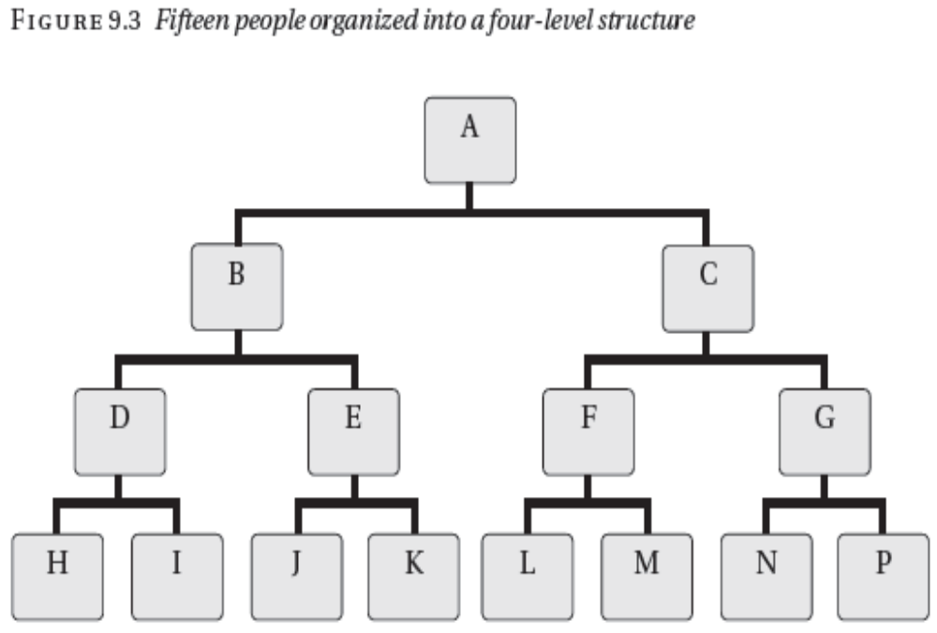
DEPTH OF STRUCTURE…..

Slide 39
DEPTH OF STRUCTURE…..
In Figure 9.3, each manager’s span of control is two and
there are four layers in the structure.
This means that the people at the bottom of the structure, such as H, have to pass through two managers (B and D in the case of H) before reaching the head of the organization, A.

Slide 40
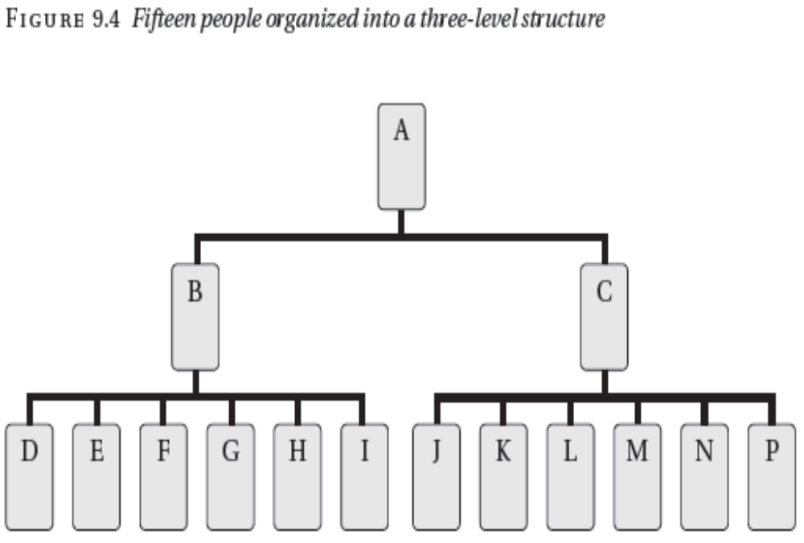
DEPTH OF STRUCTURE…..

Slide 41
DEPTH OF STRUCTURE…..
Figure 9.4 shows a flatter structure for the same number of people. Each manager’s span of control is six but the number of layers is reduced to three, meaning that people at the bottom of the structure only have to pass through one manager to reach A.
In a bureaucratic structure, managers are not expected to have more than six people reporting to them directly.
Obviously the structure of large organizations will usually be deeper than that of smaller organizations. Professional staff generally prefer to work with flatter structures.

Slide 42
CENTRALIZATION
Organizations may be centralized or decentralized. In a centralized company, the power is kept at the top of the company, with delegation only when essential.
In a decentralized company, much power and control is delegated to the lowest level.
Take a software company as an example, centralization might mean that there were company-wide rules that all programming should be done in C++ and that, Whenever a database package was needed, Oracle should be used.

Slide 43
CENTRALIZATION…..
Such a policy has advantages, that programmers could be easily moved from one part of the company to another and that a close relationship could be built with Oracle.
On the other hand, decentralization would allow more options of tools to be chosen for each project but might mean that C++ and Oracle were used for projects that would have been much better done using Java & MySQL or Visual Basic & Access.
The staff needs will be inflexible. This will cause support nightmare in the future, with staff requiring knowledge of a large numbers of obsolete tools.

Slide 44
CENTRALIZATION…..
Drawing the correct balance between centralization and decentralization is important but difficult.
Decentralization is commonly found in high-technology companies, where there is plenty of talent at lower levels.
Centralization is common in large manufacturing companies and other long-established organizations.
The ideal could be flexible centralization, in which rules & practices are laid down centrally but modifying them in specific cases will be readily be accepted. Unfortunately, putting this into practice often proves difficult.

Slide 45
SETTING UP A STRUCTURE IN PRACTICE
In most cases, an organization of any size will have a structure that is a mix of the structures defined.
Consider the case of a medium-sized company providing custom software development and consultancy and operating in several other countries through subsidiaries.
At the top level, the company has a choice. It could adopt a market sector structure, with divisions corresponding to each market sector in which it operates. Each division would be responsible for sales & marketing in that sector and operations of carrying out projects for that sector.

Slide 46
SETTING UP A STRUCTURE IN PRACTICE…..
Alternatively, it could adopt a functional structure with a sales and marketing department and an operations department.
In either case it seems sensible to have a finance and administration department, under the management of the Finance Director.
The functional structure would have the advantage of bringing together all the programmers, analysts, designers and project managers in one group and all the sales and marketing staff in another.

Slide 47
SETTING UP A STRUCTURE IN PRACTICE…..
This offers great flexibility and should enable the head of each group to deploy its staff efficiently.
If this is done, however, it will probably be necessary to structure the sales and marketing division according to market sector, because sales and marketing activity is usually only effective if aimed at specific sectors.
In order to sell in a country, it is essential to speak the language and to be familiar with the culture.

Slide 48
SETTING UP A STRUCTURE IN PRACTICE…..
In addition, despite the gradual harmonization of business rules, each country has its own laws, its own bureaucratic procedures and its own way of producing accounts.
All these factors suggest a need for a country-based organization. The best way of doing this may be to set up a subsidiary company in each country, with small office responsible for sales and marketing, and administration in that country.
The subsidiary may call on the sales & marketing division in the home country for help.

Slide 49
SETTING UP A STRUCTURE IN PRACTICE…..
The organizational structure within the operations division presents other difficulties. While a project structure is used for carrying out individual contracts for customers, some higher level structure is required. Do we group projects by market sector or by technical characteristics?
Both maybe appropriate; Projects where the risks & issues are technical are grouped into units, on the technology required, while projects with application considerations are grouped into units depending on market sector.
Figure 9.5 shows an example of such a company.

Slide 50
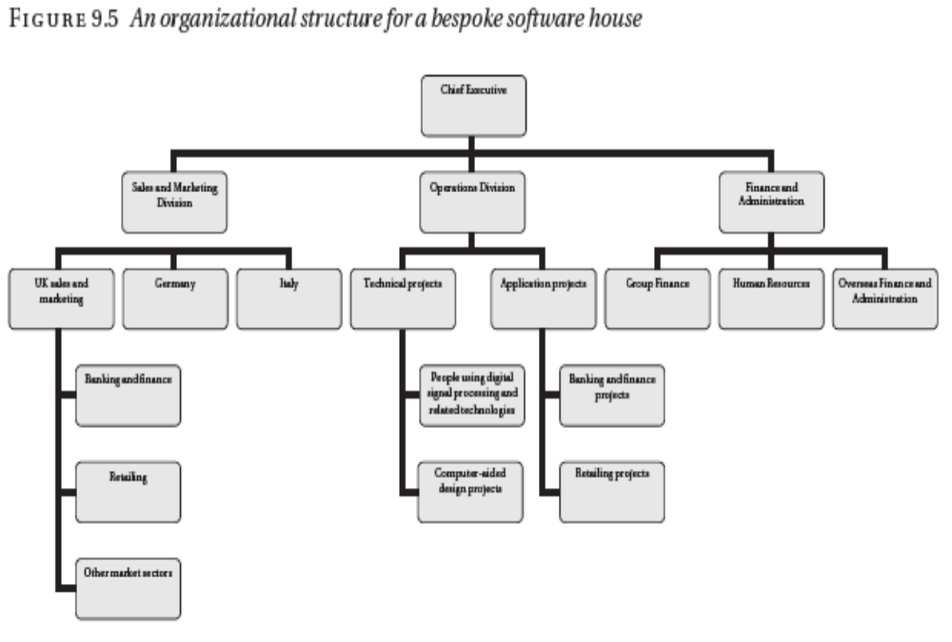
SETTING UP A STRUCTURE IN PRACTICE

